Slide 1
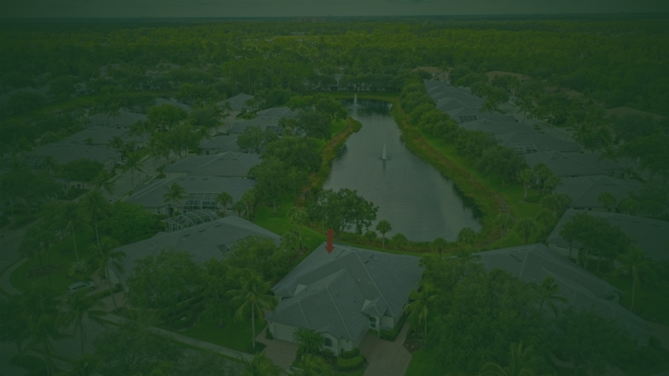
SHANTIBAN CITY
A Place to Own. A Place to Belong.
MRITYIKA REALTERS OPC PRIVATE LIMITED
TAPNA, BARUIPUR | SOUTH 24 PARGANAS | WEST BENGAL

Slide 2

Your own piece of earth. Your own story.
People dream of having a home that perfectly reflects their personality, their comfort, their lifestyle, and their aspirations.
Shantiban City gives families the rare opportunity to first own their own piece of land, and eventually build a home defined entirely by their own choices.
Ownership. Freedom. Family. Nature. Peace.

Slide 3

About Shantiban City
Shantiban City is envisioned as a peaceful, developing residential plot community. It is a carefully curated environment where families can secure their land today and create homes according to their long-term needs tomorrow.
Project: Shantiban City
Developer: MRITYIKA REALTERS OPC PRIVATE LIMITED
Area: Tapna
Location: Baruipur, South 24 Parganas, West Bengal
Distance: Approximately 20 km from Kolkata

Slide 4
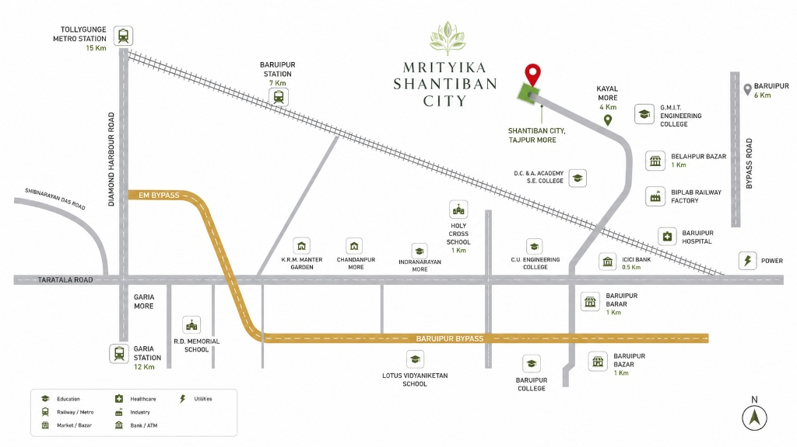

Close to what matters. Away from the chaos.
INDICATIVE MAP / NOT TO SCALE

Slide 5
Effortless Connectivity
Nearest Market ~ 500 m
Nearest School ~ 1.5 km
Koyal More ~ 1.5 km
Nearest Bus Terminus ~ 1.5 km
Nearest Hospital ~ 2 km
Baruipur Happy Valley ~ 4 km
Baruipur District HQ ~ 4.5 km
Baruipur Bypass ~ 7 km
Amtala More ~ 8 km
Garia Metro ~ 14 km
*All distances mentioned are approximate.

Slide 6
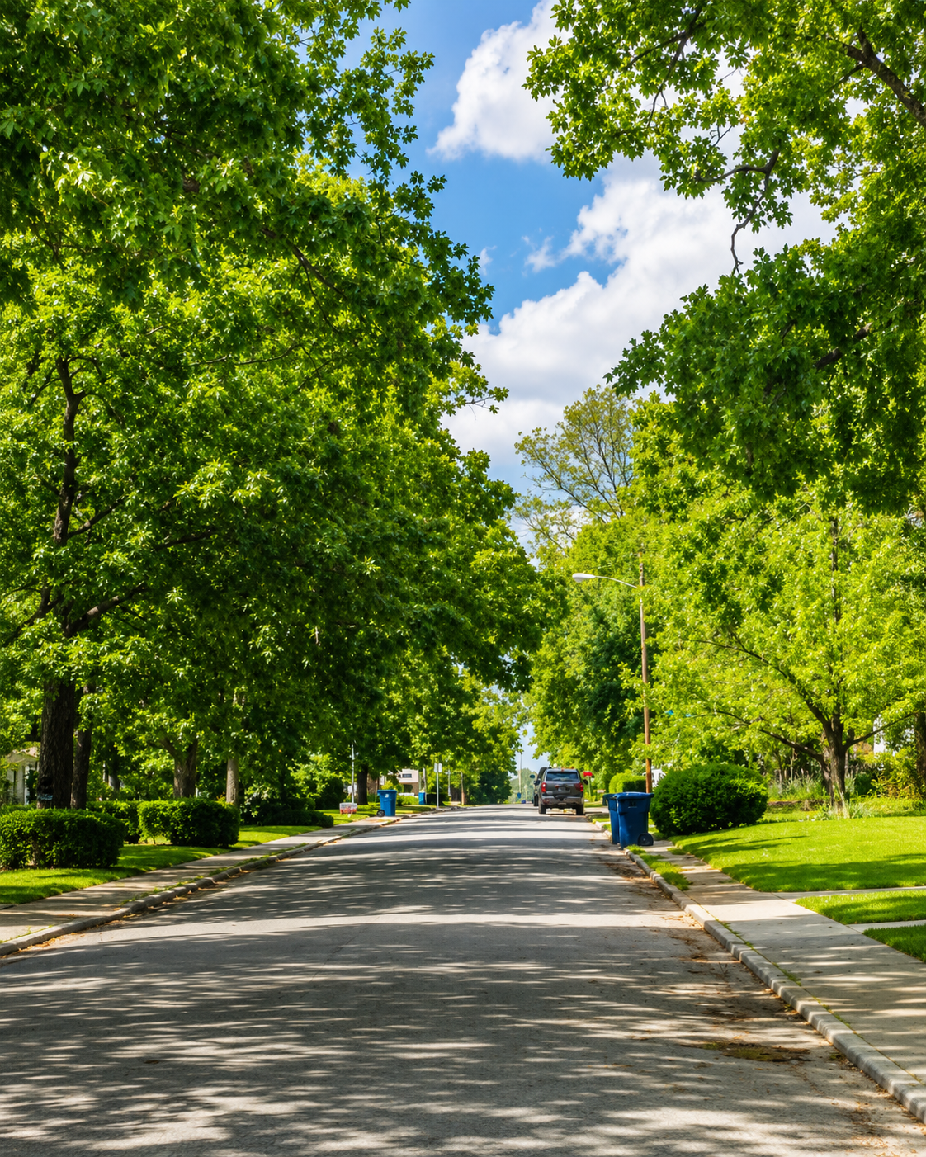
Transport & Road Accessibility
Shantiban City benefits from excellent accessibility, featuring strategic three-way road connectivity that makes daily commutes simple and efficient.
Transport readily available around the project includes:
Public Bus Services
Auto-rickshaws
Rickshaws
Easy access for Private Cars

Slide 7


Metro Connectivity
Seamlessly connected to the wider urban infrastructure, Shantiban City allows you to enjoy peaceful living without sacrificing city accessibility.
Garia Metro: Approximately 14 km
Joka Metro: Approximately 15 km
*Please note: There is also a proposed / future metro connectivity reference planned for the wider area.

Slide 8






Everything you need, within reach.
The surrounding area of Tapna, Baruipur provides ready access to everyday services and essential facilities, ensuring your family's daily life is comfortable.
Market
School
Transit
Hospital
Nearest market is approximately 500 m away.
Nearest school is approximately 1.5 km away.
Nearest bus terminus is approximately 1.5 km away.
Nearest hospital is approximately 2 km away.

Slide 9
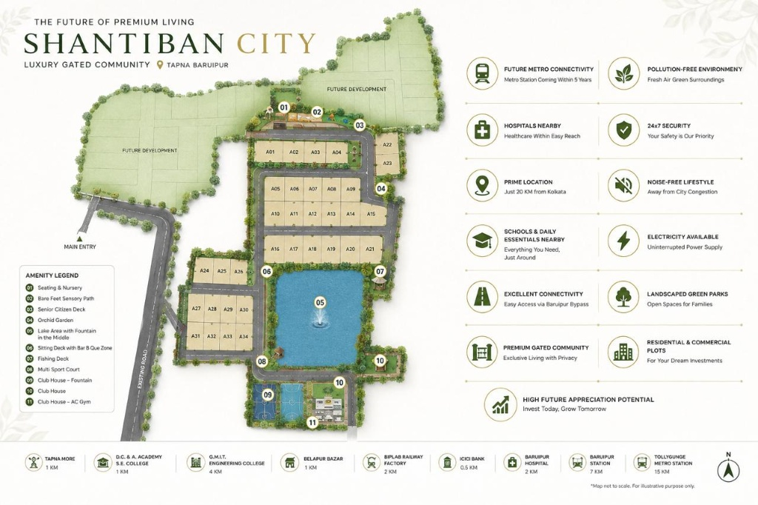


Planned Community Infrastructure
Shantiban City is designed with thoughtful internal facilities included in the development concept to elevate your everyday living:
Gated Residential Community
Security Arrangements
Wide Internal Roads
Electricity Facilities
Concrete Drainage Infrastructure
Designated Planned Park
Community Hall Space
Designated Shops / Commercial Spaces

Slide 10

Own your land. Build your home. Create your life.
A canvas for peaceful mornings, safe play for your children, and a warm neighborhood atmosphere.
Experience the joy of designing a future that perfectly aligns with your family's dreams, surrounded by a community that shares your values.

Slide 11


A Return to Nature
Escape the dense concrete jungle. Shantiban City offers a comparatively calm and naturally pleasant residential environment.
Imagine waking up to open skies, green surroundings, and the sound of quiet luxury. It is a space designed not just for living, but for deep, restorative belonging.

Slide 12

“
More than a plot. A community in the making.
Shantiban City is intended to grow as a thriving residential community rather than remain an isolated collection of plots. It is a place where families can build long-term neighborhood connections and share a unified, peaceful lifestyle.

Slide 13
Project Progress
Join a growing community of families who have already chosen Shantiban City for their future.
300+
~ 25
CUSTOMERS
CUSTOMERS
Have successfully completed their plot registration.
Have been assisted with plot identification and boundary work.

Slide 14

Why Choose Shantiban City?
Ownership
Personalization
Peace
Own your own piece of land.
Build a home around your own lifestyle.
A calm and naturally pleasant residential environment.
Connectivity
Convenience
Long-Term Vision
Access to Baruipur and surrounding urban areas.
Nearby market, school, hospital and transport.
A developing residential community designed to grow.

Slide 15

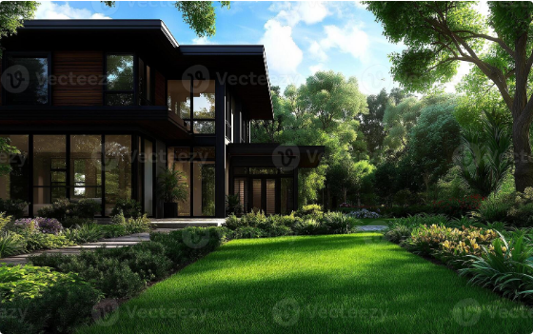
A plot is not the final destination. It is the beginning.
YOUR LAND
YOUR HOME
VISION • FAMILY • MEMORIES

Slide 16

THE DEVELOPER
MRITYIKA REALTERS OPC PRIVATE LIMITED
Committed to creating structured, accessible, and community-driven land ownership opportunities in South 24 Parganas.
Our focus is on laying the foundational infrastructure for Shantiban City, ensuring a secure environment where families can confidently invest in their future.

Slide 17

STRATEGIC GROWTH PARTNER
WebGrow360
Bridging physical real estate with digital growth, WebGrow360 is the proud Strategic Growth Partner of MRITYIKA REALTERS OPC PRIVATE LIMITED, ensuring Shantiban City reaches the families who are looking to build their future.
Real Estate + Digital Growth

Slide 18

Your piece of earth is waiting for your story.
SHANTIBAN CITY
MRITYIKA REALTERS OPC PRIVATE LIMITED
Tapna, Baruipur, South 24 Parganas, West Bengal

